Slide 1


Cover Page
The Neural Eye Machine – Giving Machines the Power to See and Think
(A Portable and Detachable AI-Powered Intelligent Vision System Using MobileNetV2 Technology)
Contact Details: audu.john@uam.edu.ng, 08135296652; iwar.raphael@uam.edu.ng, 07030920174; baloolani@gmail.com, 08144439348
Date of Presentation: 8th December 2025
Team lead: John Audu (JoSTUM)
Team Members: Rapheal Iwar, Ndudim Godwin Chisom, Collins Ebisine Kevin, Abughur Ruth Iveren, Awulu Emmanuel Oloche, wale Balogun, Theresa Kaankuka

Slide 2
Problem Statement
Lack of Intelligent Machine Vision in Key Sectors Across Africa
Agriculture: Post harvest lost is ₦3.5 trillion annual loss in Nigeria (Federal ministry of agriculture and food security, 2025).
Manufacturing: Nigeria Losses of ₦1.2 trillion over 5 years due to unaffordable automation and quality-control solutions to revive industrial competitiveness (Stransact report 2024).
Environmental Monitoring: In the last 10 years, Nigeria lost over 500,000 barrel of crude oil to environmental spillage due to poor environmental monitoring (National Oil Spill Detection and Response Agency (NOSDRA)).
Military surveillance: In the last 5 years Nigeria has witness over 1000 sudden attack from insurgents.
Common Gap: Most existing machines in Nigeria are not Intelligent driven. They depend on human inspection, which is slow, error-prone, and inconsistent.

Slide 3
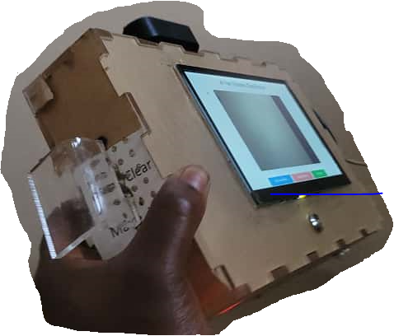
Proposed AI Solution
Introducing the Neural Eye Machine
Video Camera
Key Technical Features
AI Model: MobileNetV2-based Convolutional Neural Network for real-time object detection.
Hardware: Camera module, Raspberry Pi 4 processor, display interface, lithium battery and detachable mounting frame.
Power: Multi-source: solar, national grid, or power bank; ensuring reliability anywhere.
Reprogrammable Memory: Allows users to delete old models and train new ones for different use cases.
Integration: Compatible with agricultural, industrial, environmental, laboratory, and defense machines.
Result: Made-in-Nigeria AI system
Handle
7 Inch HDMI Display
Charging Port
Power Button
The Neural Eye Machine is a portable and detachable AI-powered intelligent vision device that gives any machine the ability to see, detect, reason, and make decisions in real time.

Slide 4
Vision and Impact
Vision Statement
Give every machine the ability to see and think
Economic Impact
Reduces losses: Cuts post-harvest and industrial product losses
Boosts productivity: Enabling industries to meet export quality standards.
Promotes local innovation: 100% Made-in-Nigeria.
Social Impact
Empowers youth and students: Builds local capacity in AI and robotics.
Supports food security: Ensures improved market value and reducing waste.
Creates jobs: Enables small and medium enterprises to adopt affordable automation tools.
Environmental Impact
Sustainable energy use: Runs on solar and low-power systems.
Supports environmental monitoring: Detects pollution, hazards, and waste using AI vision in real time.

Slide 5
Business Model and Market Opportunity
Business Model
Direct Sales Model: Sell fully assembled devices.
Customization Services: Offer retraining/reprogramming of the AI model for specific tasks.
Integration Licenses: License for integration into existing machines and robotic systems.
Training & Capacity Building: Conduct workshops and certifications on AI vision tech.
Market Opportunity
Agriculture: Nigeria loses over ₦3.5 trillion annually in post-harvest waste, a major market for AI-powered sorting and grading.
Manufacturing: Over 100,000 active SMEs in Nigeria’s agro-processing and industrial sector need affordable automation solutions.
Laboratories & Research: Demand for AI-based detection tools in lab testing is rapidly growing.
Environmental & Defense Applications: Expanding need for AI-enabled monitoring systems for hazards and surveillance.
Market Potential
With modular design, low power consumption, and affordable pricing, the Neural Eye Machine can penetrate over 60% of automation-needy sectors in Africa. A potential market worth over $1.2 billion annually in equipment and service deployment.

Slide 6
Methodology and AI Model Development
Data Collection and Preprocessing
Dataset Creation: Images of yam tubers were collected.
Preprocessing: Annotated using Labeling, resized, and normalized to improve training accuracy.
Dataset Split: 80% training, 10% validation, and 10% testing for robust model generalization.
Model Selection and Training
Algorithm: MobileNetV2 deep learning model
Training Platform: Python using TensorFlow and OpenCV frameworks.
Hardware: Trained on GPU workstation, then deployed on Raspberry Pi 4 for edge inference.
Performance Metrics: 85% detection accuracy, 100% precision, 85% recall and 92% F1 Score .
System Integration
Hardware Integration: The trained model embedded in a Raspberry Pi processes real-time image feeds from a camera module.
Interface: Results displayed on a screen and transmitted to connected machines for automated.
Power Management: Configured for multi-source operation: solar, grid, or power bank.
Model Retraining Capability
The system’s internal memory allows users to erase existing models and upload new datasets, making it suitable for any object detection or classification task: agricultural, industrial, or environmental.

Slide 7
Risk Mitigation and Ethical Considerations
Risk Mitigation & Ethical Considerations
Technical Risks & Mitigation
Potential Risk | Mitigation Strategy
Model accuracy drift over time | Periodic retraining using new datasets to maintain high detection precision.
Hardware overheating or malfunction | Incorporate cooling vents and heat sinks; real-time system health monitoring.
Power fluctuations | Multi-source power design (solar, grid, power bank) ensures continuous operation.
Data processing latency | Optimized MobileNetV2 model and lightweight processing pipeline for real-time inference.
Ethical and Responsible AI Use
Ethical Concern | Resolution
Bias in training data | Diverse image datasets collected across conditions to ensure fairness and generalization.
Data privacy | No personal or biometric data used; all datasets are product/environment-based.
Transparency | Model design, parameters, and retraining procedures are documented and reproducible.
Sustainability | Locally fabricated components and renewable energy use (solar-compatible design).
Compliance and Safety
Adheres to Nigeria Data Protection Act (NDPA 2023) standards.
Promotes ethical AI awareness through student research training.
Designed for safe human-machine interaction, ensuring no harm to users or products

Slide 8
Additional Technical and Operational Information
System Architecture Overview
Input Layer: High-definition camera captures images of target objects (e.g., yam tubers).
Processing Layer: Raspberry Pi 4 executes the MobileNetV2 AI model, detecting and classifying.
Output Layer: Detected results are displayed on a screen and transmitted to external machines.
Power Unit: Operates seamlessly on solar, national grid, or power bank sources.
Hardware Specifications
Component | Specification
Camera Module | 8MP HD with autofocus and adjustable frame rate
Processor | Raspberry Pi 4 (4GB RAM, Quad-core ARM Cortex-A72)
Power Source | 5V DC (solar, grid, or portable battery)
Display Interface | 7-inch touch-enabled LCD screen
Enclosure | Portable aluminum casing with detachable mounting
Software Stack
Operational Versatility
Programming Language: Python
Frameworks: TensorFlow, OpenCV, PyTorch, MobileNetV2
Operating System: Raspbian OS (Linux-based)
Model Deployment: Real-time inference with local retraining capability
Multi-sector applications: agriculture, manufacturing, laboratories, environmental surveillance, and defense.
Plug-and-play integration: with existing machines or robotic systems.
Designed for field conditions: lightweight, weather-resistant, and easy to maintain.

Slide 9
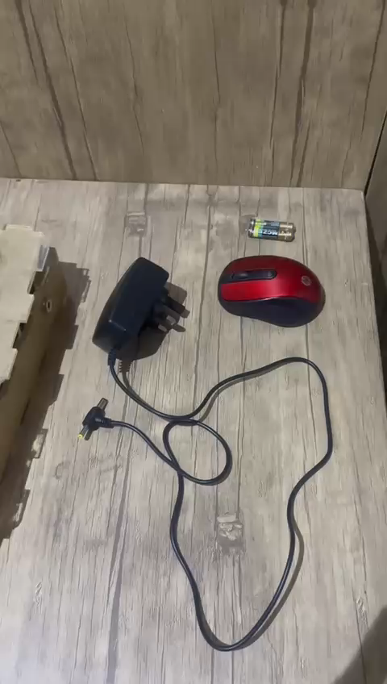
Product Demonstration

Slide 10
Conclusion/Call to Action
Conclusion
Neural Eye Machine represents a revolutionary leap in African AI innovation
A fully indigenous solution
Transforms ordinary machines into intelligent, vision-enabled systems
Capable of real-time reasoning and decision-making
Solves pressing challenges across agriculture, manufacturing, and environmental monitoring
Promote Nigeria’s self-reliance in AI technology fabrication
Call to Action
We invite:
Investors and partners to collaborate in scaling and commercializing the Neural Eye Machine for national and international markets.
Research and innovation agencies to support patenting, model expansion, and product certification.
Government and industry stakeholders to integrate this solution into agricultural, industrial, and environmental systems.

